Slide 1
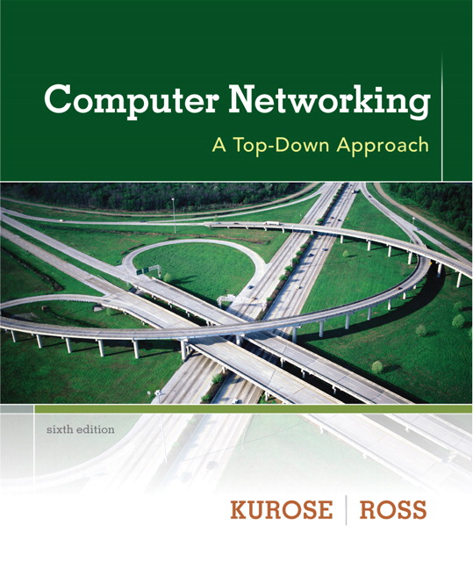
CS335
Computer Networks
Introduction 3
Computer Networking: A Top Down Approach 6th edition Jim Kurose, Keith Ross Addison-Wesley March 2012

Slide 2
Chapter 1: roadmap
1.1 what is the Internet?
1.2 network edge
end systems, access networks, links
1.3 network core
packet switching, circuit switching, network structure
1.4 delay, loss, throughput in networks
1.5 protocol layers, service models
1.6 networks under attack: security
1.7 history
Notes:
2

Slide 3
Protocol “layers”
Networks are complex,
with many “pieces”:
hosts
routers
links of various media
applications
protocols
hardware, software
Question:
is there any hope of organizing structure of network?
…. or at least our discussion of networks?

Slide 4
Organization of air travel
ticket (purchase)
baggage (check)
gates (load)
runway takeoff
airplane routing
ticket (complain)
baggage (claim)
gates (unload)
runway landing
airplane routing
airplane routing
a series of steps

Slide 5
Layering of airline functionality
ticket (purchase)
baggage (check)
gates (load)
runway (takeoff)
airplane routing
ticket (complain)
baggage (claim
gates (unload)
runway (land)
airplane routing
ticket
baggage
gate
takeoff/landing
airplane routing
airplane routing
airplane routing
departure
airport
intermediate air-traffic
control centers
arrival
airport
layers: each layer implements a service
via its own internal-layer actions
relying on services provided by layer below

Slide 6
Why layering?
dealing with complex systems:
explicit structure allows identification, relationship of complex system’s pieces
layered reference model for discussion
modularization eases maintenance, updating of system
change of implementation of layer’s service transparent to rest of system
e.g., change in gate procedure doesn’t affect rest of system
layering considered harmful?
duplicated tasks
need info only for others

Slide 7
Internet protocol stack
application: supporting network applications
FTP, SMTP, HTTP
transport: process-process data transfer
TCP, UDP
network: routing of datagrams from source to destination
IP, routing protocols
link: data transfer between neighboring network elements
Ethernet, 802.111 (WiFi), PPP
physical: bits “on the wire”
application
transport
network
link
physical

Slide 8
ISO/OSI reference model
presentation: allow applications to interpret meaning of data, e.g., encryption, compression, machine-specific conventions
session: synchronization, checkpointing, recovery of data exchange
Internet stack “missing” these layers!
these services, if needed, must be implemented in application
needed?
application
presentation
session
transport
network
link
physical

Slide 9

Encapsulation
source
message
M
application
transport
network
link
physical
segment
H_{t}
M
H_{t}
datagram
H_{n}
H_{n}
H_{t}
M
frame
H_{l}
H_{n}
H_{t}
M
link
physical
switch
destination
H_{n}
H_{t}
M
network
link
physical
M
application
transport
network
link
physical
H_{l}
H_{n}
H_{t}
M
H_{n}
H_{t}
M
H_{t}
M
H_{n}
H_{t}
M
H_{l}
H_{n}
H_{t}
M
router

Slide 10
Chapter 1: roadmap
1.1 what is the Internet?
1.2 network edge
end systems, access networks, links
1.3 network core
packet switching, circuit switching, network structure
1.4 delay, loss, throughput in networks
1.5 protocol layers, service models
1.6 networks under attack: security
1.7 history
Notes:
10

Slide 11
Network security
field of network security:
how bad guys can attack computer networks
how we can defend networks against attacks
how to design architectures that are immune to attacks
Internet not originally designed with (much) security in mind
original vision: “a group of mutually trusting users attached to a transparent network” ☺
Internet protocol designers playing “catch-up”
security considerations in all layers!

Slide 12
Bad guys: put malware into hosts via Internet
malware can get in host from:
virus: self-replicating infection by receiving/executing object (e.g., e-mail attachment)
worm: self-replicating infection by passively receiving object that gets itself executed
spyware malware can record keystrokes, web sites visited, upload info to collection site
infected host can be enrolled in botnet, used for spam. DDoS attacks

Slide 13
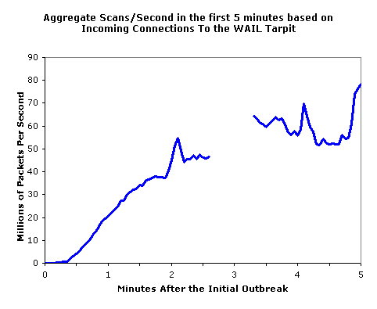
Bad guys: put malware into hosts via Internet
Trojan horse
hidden part of some otherwise useful software
today often in Web page (Active-X, plugin)
virus
infection by receiving object (e.g., e-mail attachment), actively executing
self-replicating: propagate itself to other hosts, users
worm:
infection by passively receiving object that gets itself executed
self- replicating: propagates to other hosts, users
Sapphire Worm: aggregate scans/sec
in first 5 minutes of outbreak (CAIDA, UWisc data)

Slide 14
Bad guys: attack server, network infrastructure
Denial of Service (DoS): attackers make resources (server, bandwidth) unavailable to legitimate traffic by overwhelming resource with bogus traffic
1. select target
2. break into hosts around the network (see botnet)
3. send packets to target from compromised hosts
target

Slide 15
Bad guys can sniff packets
packet “sniffing”:
broadcast media (shared ethernet, wireless)
promiscuous network interface reads/records all packets (e.g., including passwords!) passing by
A
C
src:B dest:A payload
B
wireshark software used for end-of-chapter labs is a (free) packet-sniffer

Slide 16
Bad guys can use fake addresses
IP spoofing: send packet with false source address
A
C
src:B dest:A payload
B
… lots more on security (throughout, Chapter 8)

Slide 17
Chapter 1: roadmap
1.1 what is the Internet?
1.2 network edge
end systems, access networks, links
1.3 network core
packet switching, circuit switching, network structure
1.4 delay, loss, throughput in networks
1.5 protocol layers, service models
1.6 networks under attack: security
1.7 history
Notes:
17

Slide 18
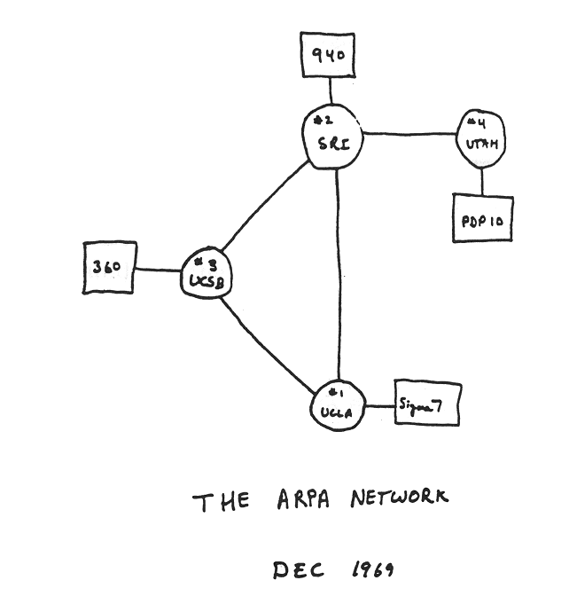
Internet history
1961-1972: Early packet-switching principles
1961: Kleinrock - queueing theory shows effectiveness of packet-switching
1964: Baran - packet-switching in military nets
1967: ARPAnet conceived by Advanced Research Projects Agency
1969: first ARPAnet node operational
1972:
ARPAnet public demo
NCP (Network Control Protocol) first host-host protocol
first e-mail program
ARPAnet has 15 nodes

Slide 19
Internet history
1972-1980: Internetworking, new and proprietary nets
1970: ALOHAnet satellite network in Hawaii
1974: Cerf and Kahn - architecture for interconnecting networks
1976: Ethernet at Xerox PARC
late70’s: proprietary architectures: DECnet, SNA, XNA
late 70’s: switching fixed length packets (ATM precursor)
1979: ARPAnet has 200 nodes
Cerf and Kahn’s internetworking principles:
minimalism, autonomy - no internal changes required to interconnect networks
best effort service model
stateless routers
decentralized control
define today’s Internet architecture

Slide 20
Internet history
1980-1990: new protocols, a proliferation of networks
1983: deployment of TCP/IP
1982: smtp e-mail protocol defined
1983: DNS defined for name-to-IP-address translation
1985: ftp protocol defined
1988: TCP congestion control
new national networks: Csnet, BITnet, NSFnet, Minitel
100,000 hosts connected to confederation of networks

Slide 21
Internet history
1990, 2000’s: commercialization, the Web, new apps
early 1990’s: ARPAnet decommissioned
1991: NSF lifts restrictions on commercial use of NSFnet (decommissioned, 1995)
early 1990s: Web
hypertext [Bush 1945, Nelson 1960’s]
HTML, HTTP: Berners-Lee
1994: Mosaic, later Netscape
late 1990’s: commercialization of the Web
late 1990’s – 2000’s:
more killer apps: instant messaging, P2P file sharing
network security to forefront
est. 50 million host, 100 million+ users
backbone links running at Gbps

Slide 22
Internet history
2005-present
~750 million hosts
Smartphones and tablets
Aggressive deployment of broadband access
Increasing ubiquity of high-speed wireless access
Emergence of online social networks:
Facebook: soon one billion users
Service providers (Google, Microsoft) create their own networks
Bypass Internet, providing “instantaneous” access to search, emai, etc.
E-commerce, universities, enterprises running their services in “cloud” (eg, Amazon EC2)

Slide 23
Introduction: summary
covered a “ton” of material!
Internet overview
what’s a protocol?
network edge, core, access network
packet-switching versus circuit-switching
Internet structure
performance: loss, delay, throughput
layering, service models
security
history
you now have:
context, overview, “feel” of networking
more depth, detail to follow!

Slide 24
Details of the Seven ISO/OSI Layers
Notes:
24

Slide 25
Physical Layer (1)
Service: moves information between two systems connected by a physical link
Interface: specifies how to send a bit
Protocol: coding scheme used to represent a bit, voltage levels, duration of a bit
Examples: coaxial cable, optical fiber links; transmitters, receivers
Notes:
25

Slide 26
Datalink Layer (2)
Service:
framing, i.e., attach frames separator
send data frames between peers
others:
arbitrates the access to common physical media
ensures reliable transmission
provides flow control
Interface: sends a data unit (packet) to a machine connected to the same physical media
Protocol: layer addresses, implement Medium Access Control (MAC) (e.g., CSMA/CD)…
Notes:
26

Slide 27
Network Layer (3)
Service:
delivers a packet to a specified destination
performs fragmentation/reassembly of packets
others:
packet scheduling
buffer management
Interface: sends a packet to a specified destination
Protocol: defines global unique addresses; constructs routing tables; implement packet forwarding; fragments/reassembles packets
Notes:
27

Slide 28
Data and Control Planes
Data plane: concerned with
packet forwarding
buffer management
packet scheduling
Control Plane: concerned with installing and maintaining the states for the data plane
Notes:
28

Slide 29
Transport Layer (4)
Service:
provides an in-order, error-free, and flow and congestion controlled end-to-end connection
multiplex/demuliplex packets
Interface: sends a packet to a destination
Protocol: implements reliability, as well as flow and congestion control
Examples: TCP and UDP
TCP: in-order, error free, flow and congestion control
Notes:
29

Slide 30
Session Layer (5)
Service:
full-duplex
access management, e.g., token control
synchronization, e.g., provide check points for long transfers
Interface: depends on service
Protocols: token management; insert checkpoints, implement roll-back functions
Notes:
30

Slide 31
Presentation Layer (6)
Service: converts data between various representations
Interface: depends on service
Protocol: defines data formats and rules to convert from one format to another
Notes:
31

Slide 32
Application Layer (7)
Service: any service provided to end users
Interface: depends on the application
Protocol: depends on the application
Examples: FTP, Telnet, WWW
Notes:
32

